Slide 1

Case Study 1: Banknote Classification (Linear SVM)
Professor Bo Liu
James Watt School of Engineering

Slide 2

Linear SVM - banknote classification
Paper money remains one of the main options for the exchange of products and services.
One of the remaining problems is the detection of counterfeit banknotes.
There are machines for detecting counterfeit banknotes, however, they are expensive…
Data were extracted from images that were taken from genuine and forged banknote-like specimens.
Wavelet transform were used to extract features from images.
Features: (variance, skewness, kurtosis, entropy) of Wavelet transformed image.
Class 1: genuine
Class 0: forged
1372 samples
See live script

Slide 3
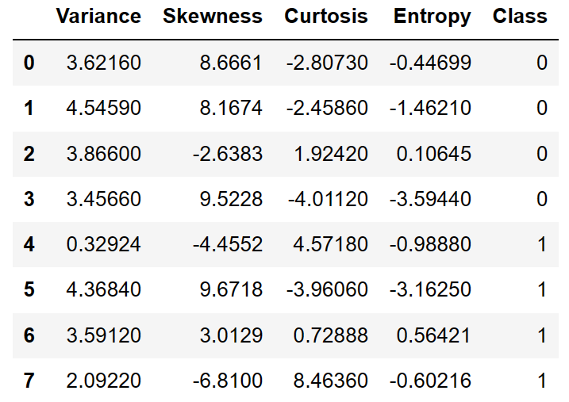
Linear SVM - banknote classification
We use SVM to classify banknotes.
1. Load the data
% load the banknote dataset
bankdata = readtable('banknote.csv');
X = bankdata{:, 1:4}; % columns 1~4 are features
y = bankdata{:, 'Class’}; % column ‘Class’ is label
Different with loading MATLAB built-in datasets, we read an external csv file.
The csv file is comma-separated values file, which can be seen as a table.
We use ‘readtable’ to read it to MATLAB.
X = bankdata{:, 1:4}; means selecting all rows, columns 1~4, and storing it to X.
Columns of bank data can also be referenced through column names.
See live script

Slide 4
Linear SVM - banknote classification
We use SVM to classify banknotes.
2. Train-test split
% Split into training and test data by the ratio 75% and 25%, respectively.
cvObj = cvpartition(size(X, 1), 'HoldOut', 0.75);
idx = cvObj.test;
X_train = X(idx, :); X_test = X(~idx, :);
y_train = y(idx, :); y_test = y(~idx, :);
reusable code
See Partition data for cross-validation - MATLAB (mathworks.com)
Throughout the lecture, we use this code snippet to split the dataset into training and test sets.
cvpartition creates a random partition of data into training and test sets.
The 'HoldOut’ parameter controls the ratio of the training set and test set.
See live script

Slide 5
Linear SVM - banknote classification
3. Training
% Train a linear SVM
svclassifier = fitcsvm(X_train, y_train, 'KernelFunction', 'linear', 'Standardize', true);
Standardizes the data by subtracting the mean and dividing by the standard deviation.
Ensures all variables are on the same scale and have equal importance to the model.
4. Prediction
% Predict
y_pred = predict(svclassifier, X_test);
accuracy_score = sum(y_test == y_pred)/length(y_test)*100; % Prediction accuracy
disp(['Accuracy: ', num2str(accuracy_score)]);
Output:
Accuracy: 97.1875
See live script

Slide 6




Thanks!
#UofGWorldChangers
@UofGlasgow

